Slide 1

IT Roadmapping Framework
Proposal for aligning Technology with Service Delivery

Slide 2

Goal
To shift the current IT focus
From: Tool-centric
To: Service-centric
so that we can optimize our portfolios of people, processes and technology.

Slide 3
Key Premises:
Functional areas & Business Units (BUs) deliver services using manual or automated (via tools) processes.
All functional areas (including IT) deliver value to each other and to the BUs by providing services.
IT provides value via 3 types of enabling services:
  Automation Services (of processes used to deliver services)
  Process Optimization Services (alignment and re-engineering of processes using Six Sigma w/in and across functional areas)
  Integration Services (across processes and systems)

Slide 4
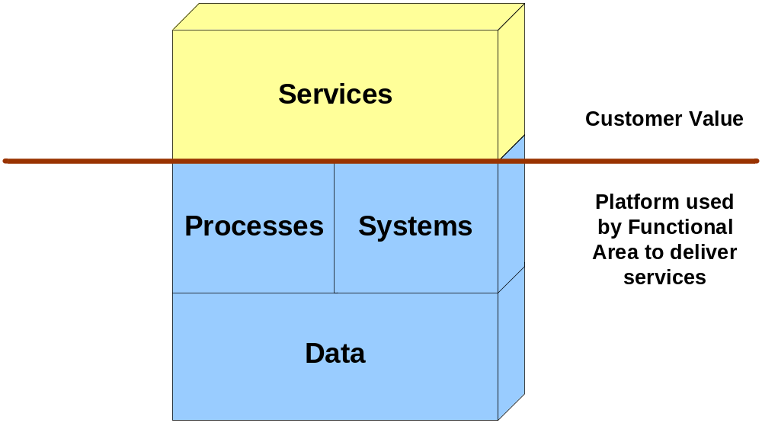
Separation of concerns
All functional areas provide services to the business.
These services are delivered through the processes and systems that support that area’s operations.

Slide 5
Why is this separation important ?
First, we elevate the discussion with internal customers (functional areas & BUs) to concerns over service delivery (which is why they exist).
We maintain focus on the operational services (the jobs) that are performed by individuals.
Request for IT services are focused on unmet needs with the jobs that customers (internal) are trying to perform (as part of their service delivery).
Success criteria for IT services can be measured by the customer’s own metrics used to measure their service level performance.

Slide 6
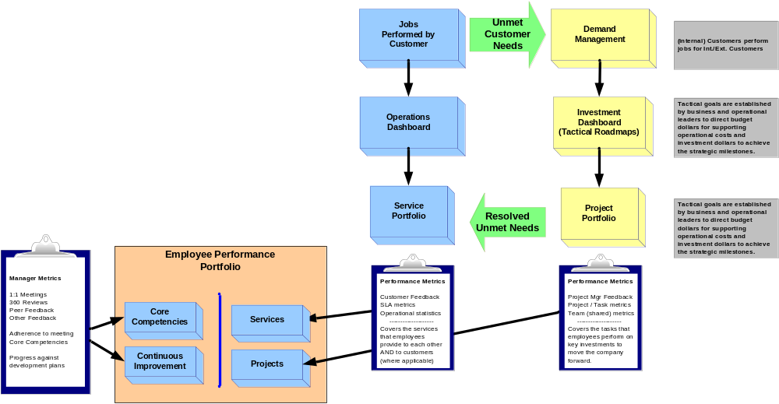
Functional Service Model
Customer Service covers ongoing & incremental service delivery.
Demand Mgmt is the key to addressing gaps in ongoing service delivery.

Slide 7
What’s different for IT ?
We have one additional portfolio to manage.
  We manage a large and complex portfolio of technology assets. These are the tools, components (software &y hardware) and modules that we buy, build and maintain to deliver automated services consumed by internal customers.
By separating the concerns, we can focus the engineering staff on optimizing the IT asset portfolio.
  Building a high performing portfolio of assets that delivers the services for our internal customers at the lowest cost.
  Continually upgrading the portfolio by removing/replacing under performing assets (those with low usage or reuse) and purchasing high performing assets.

Slide 8
Aligning Services & Technology
It’s as easy as 1-2-3:
  RLMs manage the service portfolio that we offer to our internal clients.
  RLMs identify unmet needs by our customers, prioritize them and propose projects to address the service gaps.
  Projects are then reviewed by the engineering teams (App Dev & Infrastructure) who propose changes to the IT Asset Portfolio to address the service gap:
    Buy (add or replace*) assets
    Build (extend) existing assets
* This is where we consolidate assets to maintain a low TCO

Slide 9
Next Steps for RLMs:
Review the jobs performed by staff in each functional area and Business Unit (BU).
Document the services that IT currently provides via the existing process automation (service portfolio)
Draft service portfolios for each functional area & BU.
Document the unmet customer needs by reviewing the gaps (or opportunities) in the services IT offers:
  Due to gaps in the existing process automation
  Due to requests for additional process automation
  Due to gaps/requests for integration services
  Due to requests for process optimization

Slide 10
Next Steps for Engineering Teams
Document the IT Asset Portfolio
  Hardware, Software, Components, Modules
Review the service portfolio (provided by the RLMs) and align the current IT service portfolio with the IT Asset Portfolio.
  This is a “roll up your sleeves” mapping exercise
  Identify service overlaps
  Identify underperforming assets
  Identify service gaps
Draft an action plan to optimize the IT Asset Portfolio
Draft an action plan to address the service gaps with the IT Asset Portfolio

